Slide 1
Final Project Presentation
Rusheel Shah
Elle Zadina

Slide 2
Project Description
Virtual Reality/Augmented Reality
Controlling Lampi through Microsoft HoloLens

Slide 3
Background
Why not make an augmented reality Lampi app?
We know we can control physical devices through wireless technologies (i.e. Bluetooth)
Can we control a physical device in a virtual environment?

Slide 4
Technologies
Microsoft HoloLens
NodeJS/Express
Unity
Visual Studio
HTTP

Slide 5
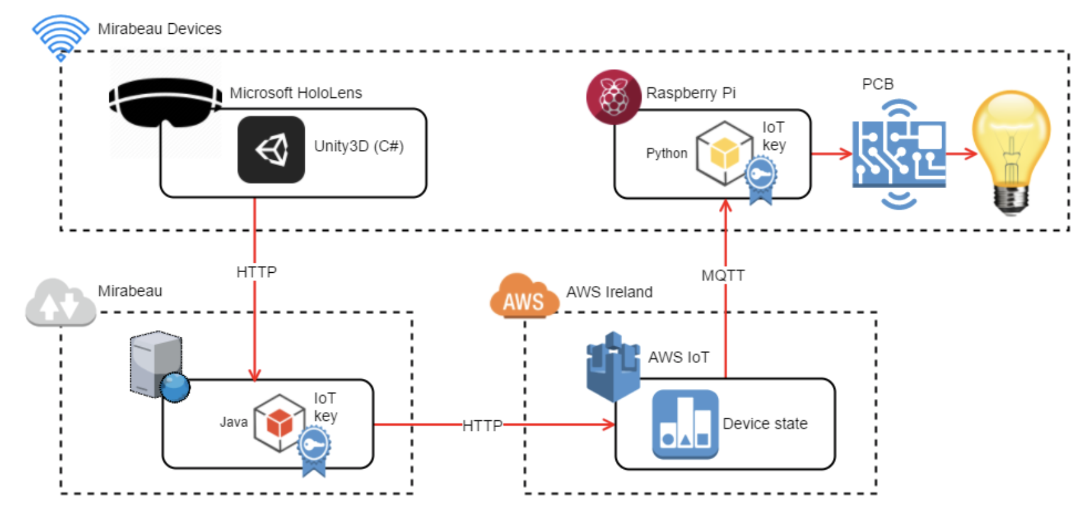
Architecture

Slide 6
Hurdles
Existing MQTT, security protocol
JSON parsing
NodeJS

